Slide 1
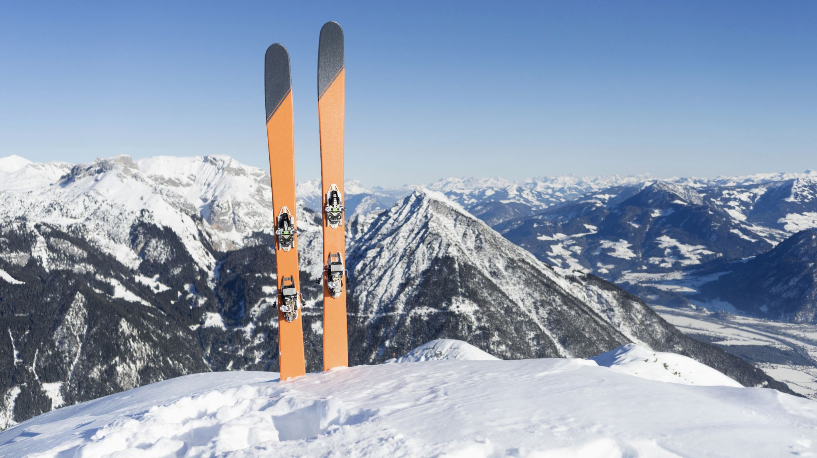
Big Mountain Resorts
Ulziibat Tserenbat

Slide 2
Contents
Problem Identification
Recommendation and key finding
Modeling results and analysis
Conclusion

Slide 3
Problem Identification
Need to find a way to reduce operation cost.
How many trails actually produce the revenue?

Slide 4
Recommendation and Key findings
The summary date set ski data has 277 observation and 36 features, of which two are categorical features: Region and state. Noted in section 3.5.4, there is no clear correlation suggesting a relationship between state and ticket price, thus suggesting a model to consider all the states together.
Top features to consider for subsequent modeling are Runs, total_chairs, vertical_drop, and last year and projected days open, as they are shown to have postive correlations to higher ticket prices. Negatively correlated features like total_charis_runs_ratio and total_chairs_skiable_ratio are counterintutitive and appears to suggest an exclusiveity vs. mass market effect; this hypothesis requires the number of vistiors per year to validate.

Slide 5
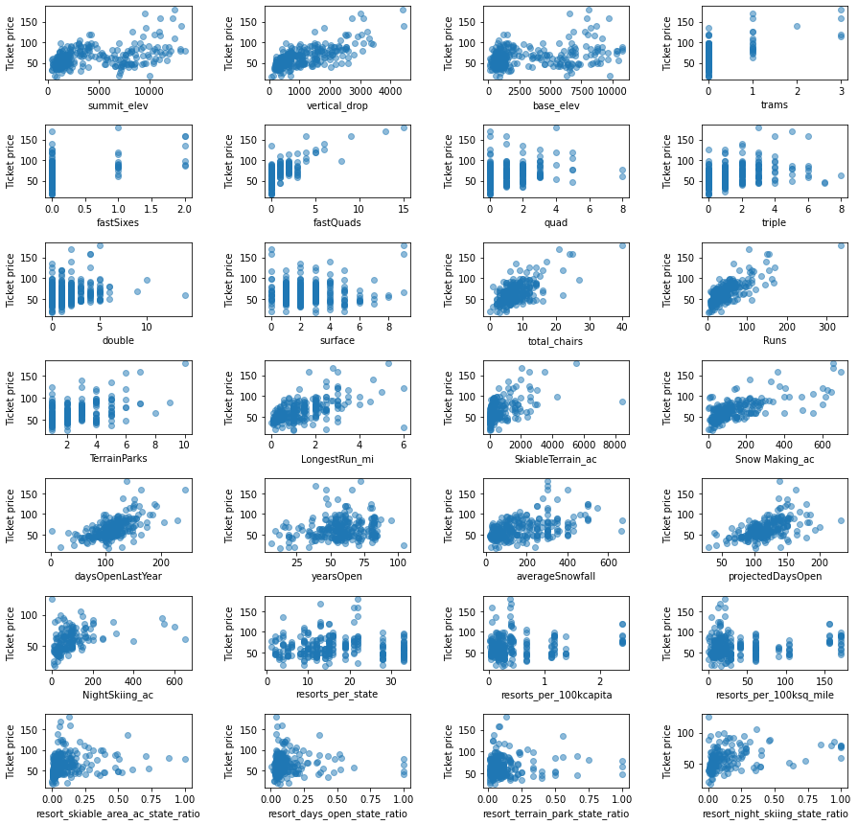
Scatterplots of numeric features against ticket price

Slide 6
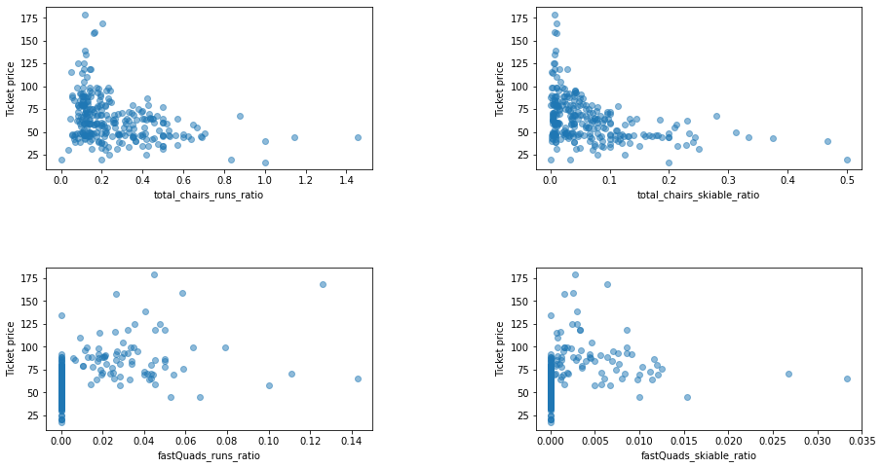
Scatterplots of numeric features against ticket price
This scatterplots show us which variables useful for further modeling. There is a strong positive correlation with vertical_drop, fastQuads, Runs, and total_chairs.

Slide 7
Modeling results and Analysis
The first modeling scenario is close the at least used 10 runs. The model says closing one run makes no difference. Closing 2 and 3 successively reduces support for ticket price and so revenue. If Big Mountain closes down 3 runs, it seems they may as well close down 4 or 5 as there's no further loss in ticket price. Increasing the closures down to 6 or more leads to a large drop.
The second scenario is Big Mountain is adding a run, increasing the vertical drop by 150 feet, and installing an additional chair lift.

Slide 8
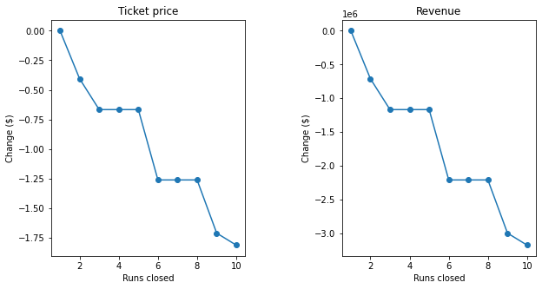
Modeling results and Analysis

Slide 9
Modeling results and Analysis
One-day adult ticket is currently priced at $81. Assuming average visitors ski for 5 days and 350,000 visitors in the coming season, the model predicts $3.47 million increase in revenue from raising the ticket price by and adding a run 150 ft lower down and a chair lift to support it.
The model, however, does not account for the additional captial expenditure and on-going operation since this data has not been provided. It is assumed that the additional chair lift would increase the operating cost by $1.54 million.
Further, closing one of the least used run is expected to have no impact to existing revenue. Closing successive 2 to 5 least used runs however would erod the support of current price.

Slide 10
Conclusion
The price predicting model suggests the potential for raising the price above $83 (potentially much higher), but this would mean making additional enhancements to the facility to support the price increase. The resort is already positioned in the premium segment of the market and is priced competitively compared to other resorts offering similar amenities. Since Big Mountain has an geographical advantage to compete in the premium market, upgrading the facility to charge a higher price while attracting more visitors would increase the resort's competitive advantage in a pro market cycle.
Additional consideration to improve the model, as the next step, is to source and incorporate (1) operating cost data into the consider and (2) visitor volume across the U.S. Surveying the market for willingness to pay a premium by amenities and features should be considered as well.
Other consideration, invite a cross-functional team of business experts to try the model and test the business assumptions. To make the model assessable, the model could package in an API that can either called directly from a spreadsheet or is embedded and deployed through an interactive dashboard accessible via the intranet.

